Slide 1
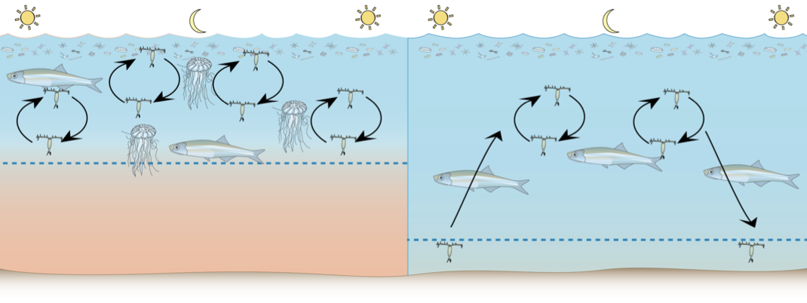
DeZoZoo Investigators Meeting 31 March 2011

Slide 2
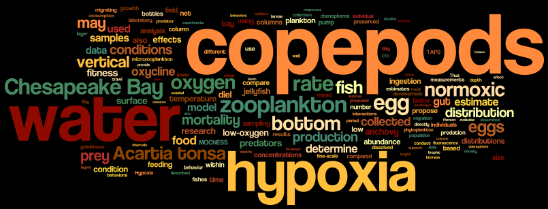
What the hell are we doing here? -”Creep”, Radiohead 1992
Introduction

Slide 3
Our goal
Develop a mechanistic understanding of how the behavior and fitness of copepods is influenced by hypoxia.
How are these effects expressed in the population abundance, distribution and trophic dynamics?

Slide 4
Themes & Hypotheses
Behavior, Distribution, and Abundance
Organism Fitness
Copepod Mortality

Slide 5
Behavior, distribution, and abundance
Hypothesis I:
Low-oxygen bottom waters exercise control over the vertical distribution and migration behavior of copepods.
Copepods may either avoid hypoxic waters or they may be found in hypoxic waters at least part of the day, moving between layers of low-oxygen water and overlying normoxic water.

Slide 6
Organism Fitness
Hypothesis II:
Low-oxygen bottom waters reduce the fitness of copepods.
Low-oxygen bottom waters may directly reduce copepod fitness through physiological stress, but low dissolved oxygen also may indirectly enhance the fitness of copepods if their food is aggregated in layers within the oxycline.

Slide 7
Copepod Mortality
Hypothesis III:
Low-oxygen bottom waters increase mortality rate by directly killing copepods and their eggs.
Alternatively, hypoxic bottom waters may increase the rate of copepod mortality indirectly by enhancing trophic interactions between copepods and their fish and jellyfish predators.

Slide 8
Synthesis and comparative modeling
Individual based model of copepod foraging behavior in response to hypoxia
Based on Leising et al. (2005) and adapted for the Chesapeake and Acartia
Based on Gentleman et al 2009, Neuheimer et al 2010

Slide 9
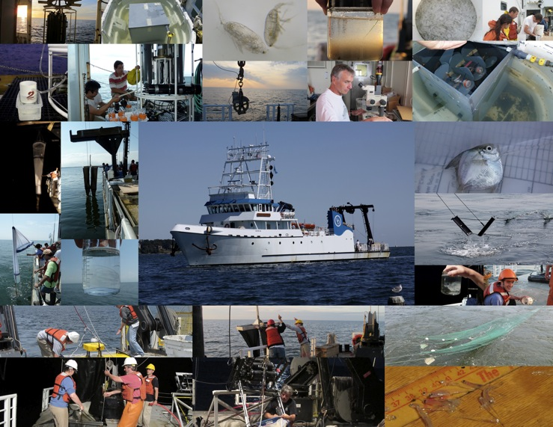
Walked the sand with the crustaceans -”Wave of mutilation”, Pixies 1989
Results – Hydrography and Plankton (I)

Slide 10
Time Series
Depth profiles of 8 samples:
3 surface samples
2 pycnocline samples
3 deep samples
Time Series
Station
X
June 16
August 30
October 18
May 17
June 7
July 9
August 5
Salinity
Bottom
Oxygen
July, 2004
Slide Courtesy M. Doherty
Notes:
To capture community changes through the different strata, we took all of the samples at eight depths – three in the surface layer, three in the bottom layer and two in the interface.
This graph integrates the salinity data over our 7 time series samples from May to October at the same station.

Slide 11
Time Series
Redox conditions shifted over time:
Hypoxic to suboxic to sulfidic to suboxic to hypoxic
May
October
Time Series
Station
Oxygen (mg/l)
X
hypoxic
sub-oxic
sulfidic
sub-oxic
hypoxic
H₂S (µM)
Bottom
Oxygen
July, 2004
Slide Courtesy M. Doherty
Notes:
Over the summer redox conditions shifted from hypoxic to suboxic to sulfidic, and then back the other way.
Suboxic is anoxic, meaning zero oxygen, but with little to no hydrogen sulfide.
Suboxic conditions are where we expect to see intermediate respiratory metabolisms like denitrification and metal reduction.
Our time series station is plotted here on the map. Each of the dashed lines on the graph correspond with the sampling dates on the previous slide.

Slide 13
Longitudinal Survey
Time Series
Station
X
Salinity
Bay Bridge
Chester R
Choptank R
Patuxent R
Potomac R
Bottom
Oxygen
July, 2004
Slide Courtesy M. Doherty
Notes:
To capture community changes through the different strata, we took all of the samples at eight depths – three in the surface layer, three in the bottom layer and two in the interface.
This graph integrates the salinity data over our 7 time series samples from May to October at the same station.

Slide 14
Redox conditions ranged from hypoxic to sulfidic
Longitudinal Survey
X
Oxygen (mg/l)
X
X
Old sulfidic
X
sulfidic
sub-oxic
hypoxic
H₂S (µM)
X
Bottom
Oxygen
July, 2004
Slide Courtesy M. Doherty
Notes:
Again, these samples represent the evolution of the anoxic zone from hypoxic to suboxic to sulfidic. The northernmost point was selected to represent the oldest time period of sulfidic waters
For each station and time point we collected samples to quantify microbial communities based on rDNA and rRNA abundance.

Slide 17
Biomass and microplankton composition differed in May 2010
Normoxic
Hypoxic

Slide 18
Microplankton communities were similar in August 2010
Normoxic
Hypoxic

Slide 19
Similarities in microplankton communities remained in September
Normoxic
Hypoxic

Slide 20
OPC data show patchy size-specific zooplankton distribution and zooplankton presence in hypoxia

Slide 21
Acartia tonsa female abundance is centered on the oxycline, with some in the hypoxic zone

Slide 22
To be continued
3 cruises in 2011
Fish and Gelatinous Zooplankton gut contents
Egg and post-embryonic mortality
Curricular materials based on our findings
COSEE Coastal Trends, Laura Murray and Deidre Gibson
Comparison with other hypoxic systems

Slide 23
May 2010 OPC data show patchy zooplankton distribution throughout the bay

Slide 24
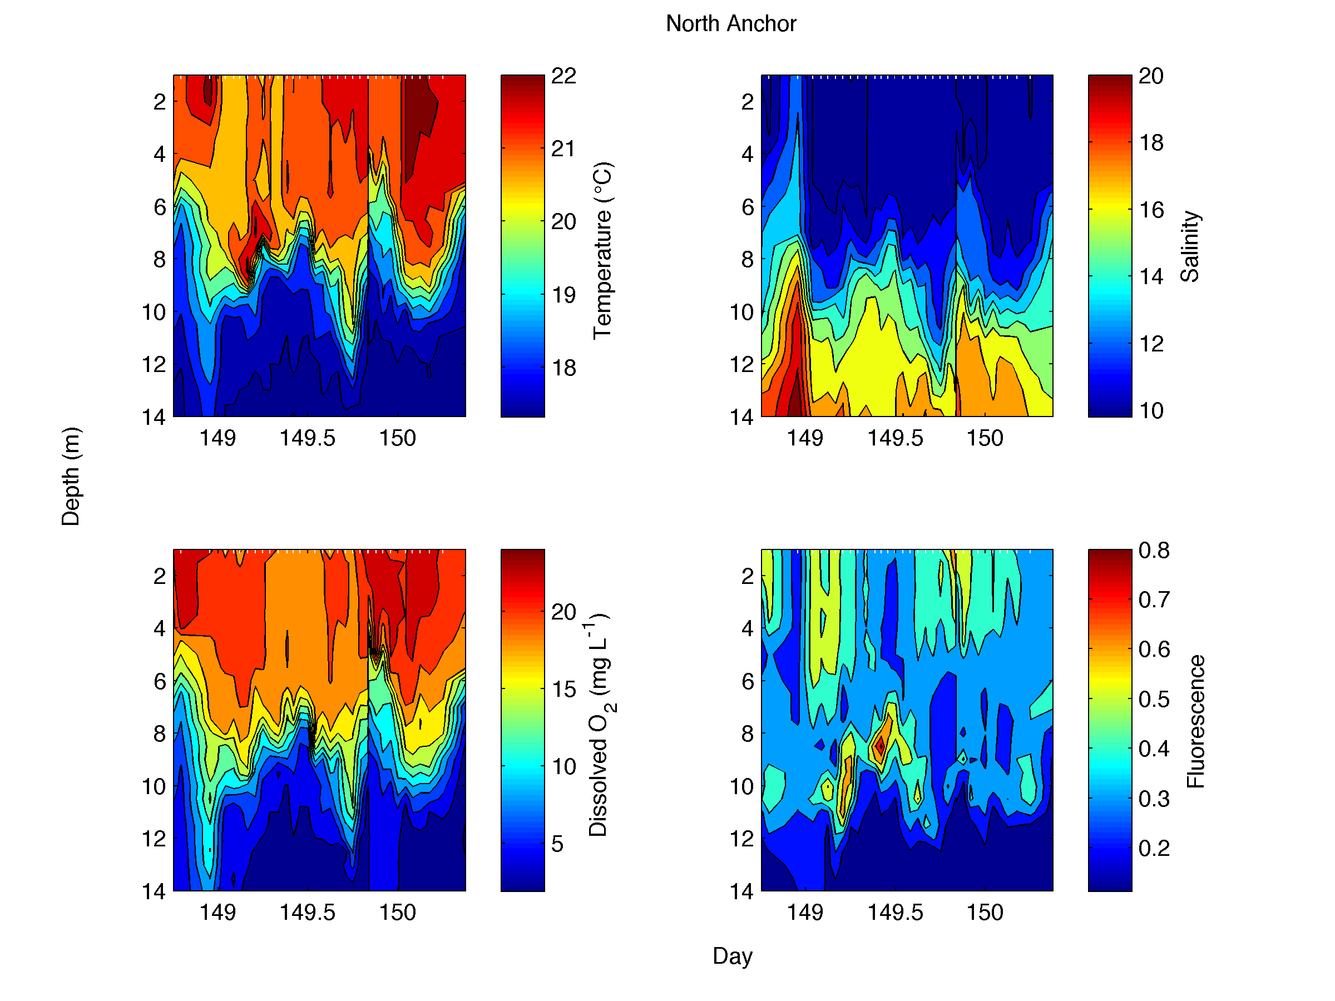

Slide 28
Next: David, Ali, Ed

Slide 29
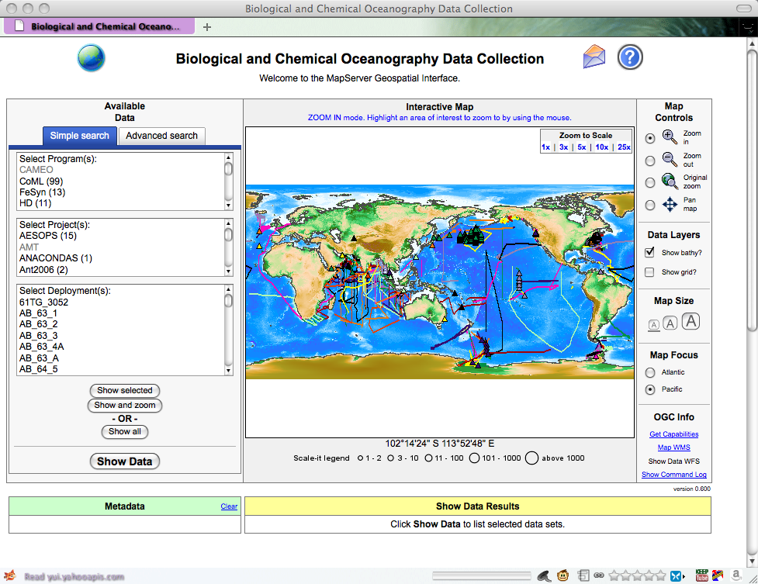
Numbers, Letters, Learn to spell -”We’re going to be friends”, The white stripes 2002
Data Management

Slide 30
DISCUSS!

Slide 31
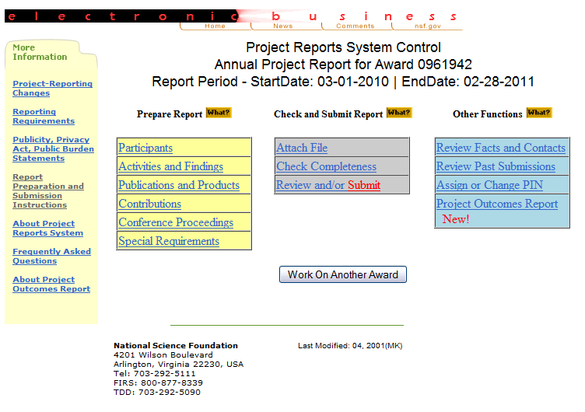
Show me how you do that trick -”Just Like Heaven”, The Cure 1997
Annual Report

Slide 32
DISCUSS!

Slide 33
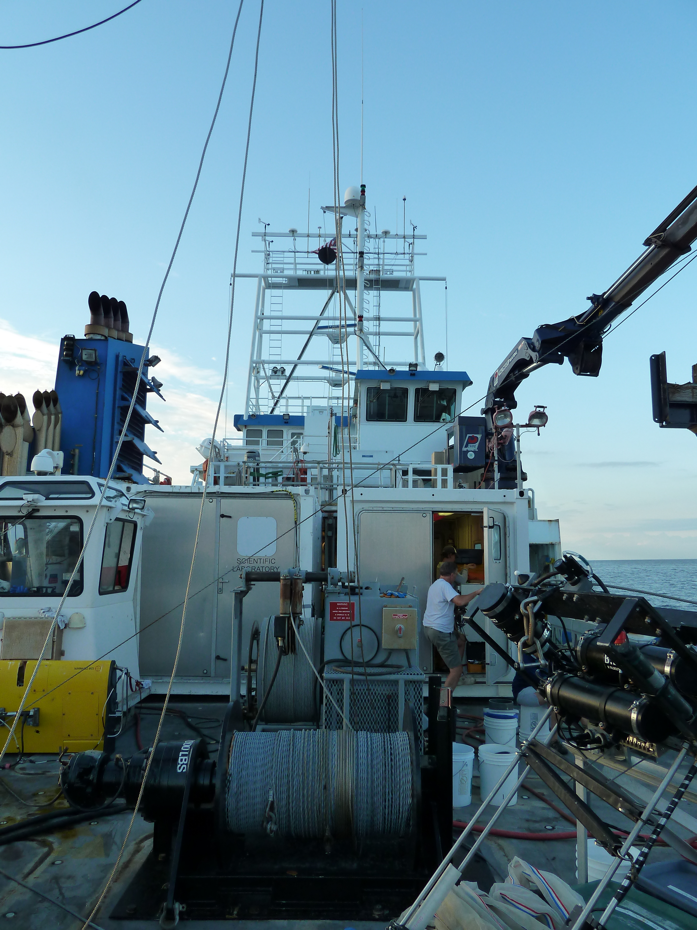
tramps like us, baby we were born to run -”Born to Run”, Bruce Springsteen 1975
Planning 2011 cruises

Slide 34
Cruise Plan
 | 21-Sep | 22-Sep | 23-Sep | 24-Sep | 25-Sep | 26-Sep | 27-Sep
Time (Local) | Location
0:00 | Transit | Anchor at S. Station |  |  | Dusk, Dawn,
1:00 | Cambridge - Bay Bridge | ~Rappahannock Shoals |  |  | Midnight, and Noon |  | Hypoxic Station - CBL to offload
2:00 |  |  |  |  |  | CTD, MOC, TT, MWT
3:00 |  | CTD casts hourly |  | CTD, MOC, TT, MWT | Experiments
4:00 | CTD |  |  |  | Grazing
5:00 | Scanfish Survey | Z-Traps |  |  | Egg Production |  | CBL - Cambridge to demobilize
6:00 | Bay Bridge to Rappahannock Shoals | 4 consecutive series at |  |  | Neutral Red
7:00 |  | Dusk, Dawn, | CTD, MOC, TT, MWT |  |  | CTD, MOC, TT, MWT
8:00 |  | Midnight, and Noon |  | Bay Bridge
9:00 |  |  |  | OXIC station to HYPOXIC station
10:00 |  | Experiments
11:00 |  | Grazing
12:00 |  | Egg Production | CTD, MOC, TT, MWT |  |  | CTD, MOC, TT, MWT
13:00 | Stop at CBL to pick up scientists | Neutral Red
14:00
15:00
16:00 |  |  |  | Bay Bridge
17:00 |  |  | CTD, MOC, TT, MWT | Anchor at S. Station |  | CTD, MOC, TT, MWT
18:00 |  |  |  | ~Rappahannock Shoals
19:00
20:00 |  |  |  | CTD casts hourly
21:00 | CTD
22:00 | Transit |  | CTD, MOC, TT, MWT | Z-Traps |  | CTD, MOC, TT, MWT
23:00 | Rappahannock Shoals to OXIC station |  |  | 4 consecutive series at
7 day cruises
Axial surveys
Diel studies
48+ hours:
24 at anchor
24 towing nets
Hypoxic site
Oxic site

Slide 35
Proposed Cruise timing
May/June
ctenophores are a dominant predator
hypoxia is becoming established in the up-estuary portion of the mid-Bay and progressing southward
August/September
sea nettles, ctenophores and bay anchovy are all important copepod predators
bottom-water hypoxia/anoxia is well established
October/November:
sea nettles and ctenophore stocks decline, bay anchovy young of year numbers and biomass peak
hypoxic conditions break down due to more frequent mixing events

Slide 36
DeZoZoo UNOLS Cruise Dates
May 25-31
July 19-25
September 20-26

Slide 37
Other Opportunities For CB Cruises
LiDZ
Crump, Cornwell, Hewson
Weekly cruises to CB4.3C on the Parker
July 7-13 on Sharp
Oyster Transport
North
July 14-18
M. Rubra ecology
Johnson & Stoecker
May 4-9
Oct 16-21

Slide 38
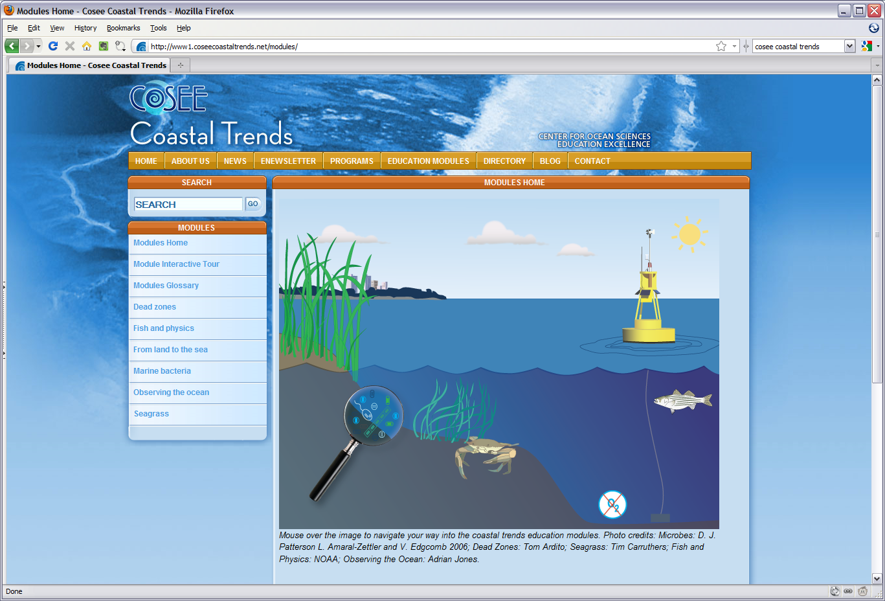
Expanding the horizons and expanding the parameters -”Sounds of Science” Beastie Boys 1989
Planning Science-Educator Partnership for summer 2011

Slide 39
Broader Impacts
COSEE Scientist-Educator Partnership program
Middle or High School teacher at HPL for 6-week residential program
Create an education module which will focus on zooplankton (e.g. copepods) and their survival in coastal systems.
Comprehensive dissemination of the modules via the web, hands-on workshops, and conferences
www.lifeinthedeadzone.org

Slide 40
Advertisement for SEP
Topic: Plankton and the Dead Zone Location: University of Maryland Center for Environmental Science Horn Point Lab, Cambridge, MD
Zooplankton are the gateway for energy and material flowing through the aquatic food web. The direct effects and behavioral changes of zooplankton caused by low oxygen can affect the food web in various ways. Scientists at the UMCES HPL are seeking to understand these effects and changes to zooplankton populations as well as implications for the overall aquatic food web.
The teacher selected for this project will participate in scientific research and create web resources and lesson plans to communicate the research to 6-12th grade students. Under the direction of Dr. James Pierson, research is slated to include cruises on the Chesapeake Bay which will examine zooplankton responses to low oxygen by both surveying the study sites to locate the extent of low oxygen zones and conducting experiments at two stations - one with low oxygen levels and one with higher levels. A suite of measurements and experiments will be performed on the ship to look at where the zooplankton are in relation to their food, their predators, as well as the rates of feeding, reproduction, and migration of the zooplankton. In addition, laboratory experiments will quantify the sub-lethal effects of low oxygen on zooplankton growth and development. While learning about research and plankton ecology, the teacher will also develop educational materials to help convey Dr. Pierson’s research to broader audiences.
http://www.coseecoastaltrends.net/programs/scientisteducatorpartnership/teacherresearchexperience/

Slide 41
Key Dates
June 1 Students arrive at HPL
Timed to coincide with REUs
June 27 Teachers arrive and have orientation
August 5 Program ends
Module should be complete

Slide 42
2 Scientist-Educator Teams
Each team consists of undergrad from Hampton University and a Teacher
Module Topics:
Plankton
Marine Food Webs

Slide 43
Goals and Responsibilities
Students will gain real science experience:
Lab work
Cruise experience
Oversee their lab work and educational material development
Make sure the teacher and students understand the science and can communicate

